Slide 1


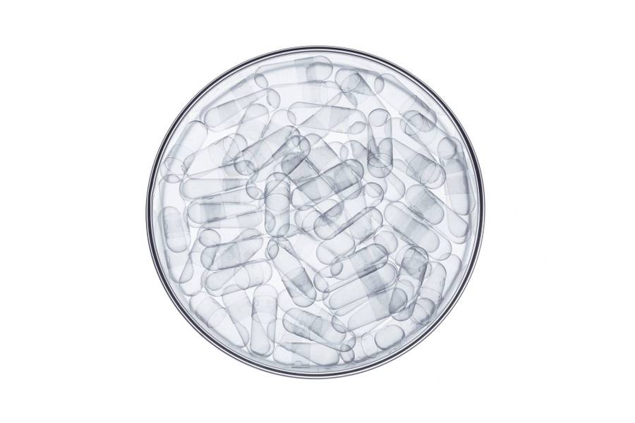
‘Crop Janitortopic name don’t change’
VISVESVARAYA TECHNOLOGICAL UNIVERSITY, BELAGAVI
Project presentation on,
Priyanka B H
1VE19EC082
Neethushree.K
1VE19EC070
Harsha B A
1VE19CS054
Harish Thanikaivelu
1VE19CS052
Under the guidance of:
&
Dr.Poornima G R
Mrs.Niranjana C

Slide 2

Agenda
Introduction
Problem Statement
Objectives
Methodology
Advantages
Conclusion
Literature Survey & References

Slide 3
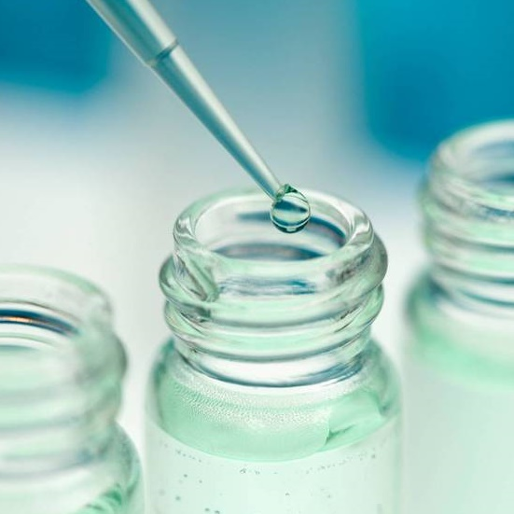
Introduction
India has a typical climatic conditions prevailing which is a huge challenge for the farmers.
The crops are prone to diseases and deficiency due to this.
This project aims to be a personalized care given to the crops based on the problems arising in the crops and provide proper fertigation for the crops to survive and produce good yields.
And hence the name, ‘Crop Janitor’.
Reference taken from the literature: Monirul Islam Pavel, Syed Mohammad Kamruzzaman, Sadman Sakib Hasan, “An IoT Based Plant Health Monitoring System Implementing Image Processing”, Volume-5, Nov-2019.

Slide 4
What is Fertigation?
Fertigation is a method of fertilizer application in which fertilizer is incorporated within the irrigation water by the drip system. In this system fertilizer solution is distributed evenly in irrigation. The availability of nutrients is very high therefore the efficiency is more. In this method liquid fertilizer as well as water soluble fertilizers are used. By this method, fertilizer use efficiency is increased from 80 to 90 per cent.
What is Smart Farming?
Smart farming or Smart Agriculture system is the term used to describe the adoption of modern information and communications technologies in order to enhance, monitor, automate or improve agricultural operations and processes.

Slide 5
Design of automatized disease detection and fertilization system for agricultural crops
Problem Statement

Slide 6
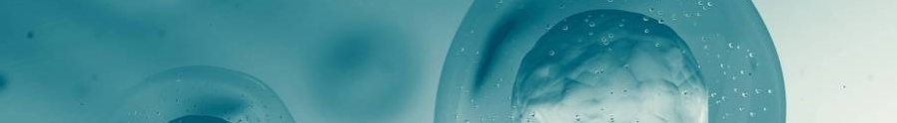
Literature Survey & References
Paper | Pro’s | Con’s
Monirul Islam Pavel, Syed Mohammad Kamruzzaman, Sadman Sakib Hasan, “An IoT Based Plant Health Monitoring System Implementing Image Processing”, Volume-5, Nov-2019. | Adding the functionalities to any current agribusiness industry can possibly incredibly recognize plants wellbeing and ready to take choices a lot quicker. | Gives just information about execution of the project but not executed practically
Yingying Dong, G Fang Xu, “Monitoring and forecasting for disease and pest in crop based on WebGIS system”, Volume-2, issue-10, 2019. | System development includes data, calculation and production modules, each module maintains a high cohesive and low coupling relationship. Through the browser to access the system, simple, quick, and easy to operate. | This is the sophisticated project which include huge amount of data. So maintain the data and the result is the challenging task for the user.

Slide 7
Literature Survey & References
Paper | Pro’s | Con’s
Siddharth Singh Chouhan, Ajay Kaul, Uday Pratap Singh, “A deep learning approach for the classification of diseased plant leaf images”, Volume-6, issue-9, 2019. | The average accuracy of this model is 98.24%. | In future, the presented model can be further enhanced for the classification of different plant leave and diseases.
Rohit Nalawade, Apoorv Nagap, Lakhan Jindam, “Agriculture field monitoring and Plant Leaf Disease Detection”, Volume-10, Issue-6, 2020. | This system can periodically monitors the cultivated field and successfully shows the status on the application | The proposed system can be further extended by adding extra functionalities like location of stores present nearby user, list of pesticides and fertilizers, real-time interaction with agriculture experts via chatting or video call, etc.

Slide 8
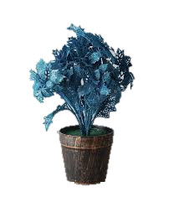
Objectives
To design a appropriate plant growth monitoring system.
Use of Artificial Intelligence image processing to find the Growth of the Plant.
To analyze the growth and to predict the health condition of the plant using leaves.
To Identifying the Plant Disease using Machine learning algorithm. After the disease is identified, Identifying the suitable pest for that disease.
Treat the crops with the correct fertilizers.

Slide 9
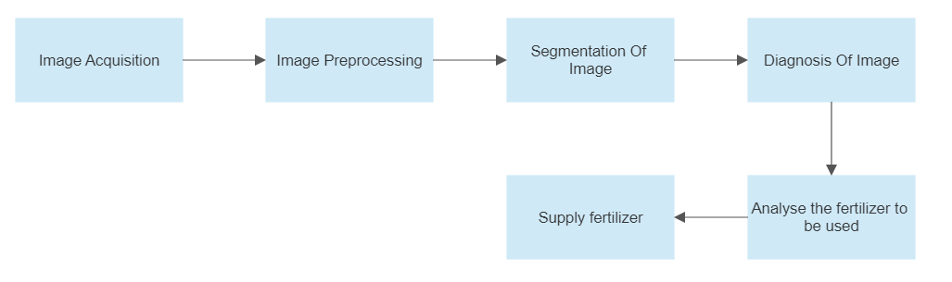
Methodology
AI Module
This module is responsible for the disease prediction in the crops by scanning the leaves.
IoT Module
This module is responsible for the fertigation of the crops based on the data provided by the AI module.
These two modules must be integrated and coordinated to be used.
Process flow illustration flowchart.

Slide 10
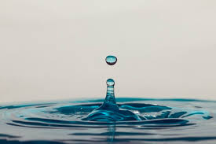
Advantages
This method can increase the yields.
Farmers can control the use of fertilizers.
The quality of the produce is better.

Slide 11
Conclusion
There is a huge increase in the yields and this benefits the overall growth in the GDP contributed by the agricultural share in the country.
There is quality produce which means there is very less wastage due to bad goods and this can support the surplus needs of the population.
Precise amounts of fertilisers when given to the crops there is no chances of soil pollution due to the excessive amounts of use of fertilisers.

Slide 12
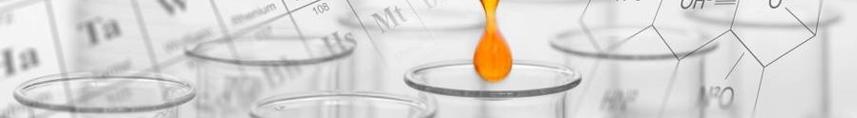
Timeline
Step 1
Step 2
Step3
Step 4
Step 5
Generate a detailed analysis of diseases in crops.
Develop an algorithm based on AI and ML for the diseases in crops.
Test the AI Module.
Develop an IoT module for the fertigation of the diseased crops.
Integrate both the modules and test the final prototype.

Slide 13

Q&A

Slide 14

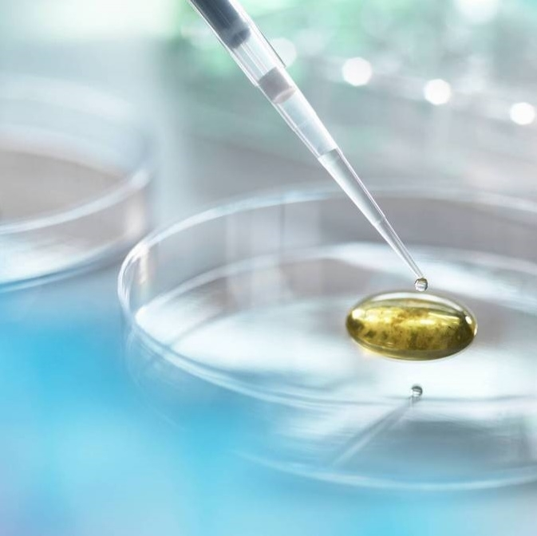
Thank you

